Slide 1

Artificial Intelligence Techniques for Load Forecasting in an Electric Utility
CSE(AI)-B
GROUP 14
EEE & UID
GROUP MEMBER
VARSHITHA
MEERA NAMBIAR
YASHWANTH V
ROLL NO:
CB.SC.U4AIE24114
CB.SC.U4AIE24132
CB.SC.U4AIE24160

Slide 2

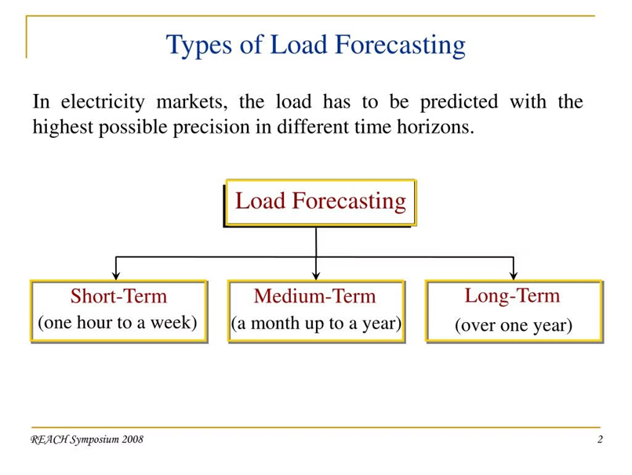
INTRODUCTION:
What is Load Forecasting?
Short-Term Load Forecasting
Predicting load accurately allows utilities to optimize power generation, reduce costs, and improve operational efficiency.
Load forecasting predicts the demand for electricity at different times in the future, considering factors like weather, season, and historical data.
Short-term load forecasting focuses on predicting demand in the near future, typically from a few hours to a few days ahead.
Load forecasting helps utilities plan, procure, and allocate power resources efficiently, ensuring energy is produced and distributed without waste.
Accurate load forecasting helps keep the power grid stable by predicting changes in electricity demand, ensuring that electricity is always available when needed.

Slide 3


Improved Accuracy
Real-Time Adaptability
AI techniques like ANN and SVM can learn complex patterns in data, leading to more accurate predictions compared to traditional methods.
AI models update forecasts with real-time data, ensuring accuracy in changing conditions. This helps make better decisions in unpredictable situations.
Role of Artificial Intelligence in Load Forecasting
Automated Processes
AI automation simplifies load forecasting, cutting down on manual work and allowing resources to focus on more important tasks.

Slide 4
Literature review
S.NO | YEAR | TITLE | METHODOLOGY | Key Contribution
1 | 2018 | Short-Term Load Forecasting With Deep Residual Networks | using Deep Residual Networks (ResNets) | The key contribution of this method is using Deep Residual Networks (ResNets) to accurately predict short-term electricity demand, improving load forecasting and supporting efficient energy management.
2 | 2008 | Short-term load forecasting method based on structural neural network | Using structural neural network | The method uses a structural neural network to analyze past electricity data, identify patterns, and accurately predict short-term load for better energy management.

Slide 5
3 | 2020 | Weekly Peak Load Forecasting for 104 Weeks Using Deep Learning Algorithm | This method applies a deep learning algorithm to analyze historical electricity data and predict weekly peak load for 104 weeks, ensuring accurate forecasting. | It improves forecasting accuracy, captures complex load patterns, and enables efficient long-term energy planning using deep learning
4 | 2023 | An Artificial Intelligent Load Forecast Method Using Image Based LSTM | This method converts historical load data into images and uses an Image-Based LSTM model to analyze patterns and accurately forecast electricity demand. | It introduces a novel image-based approach for load forecasting, enhances pattern recognition using LSTM, and improves prediction accuracy for efficient energy management.

Slide 6
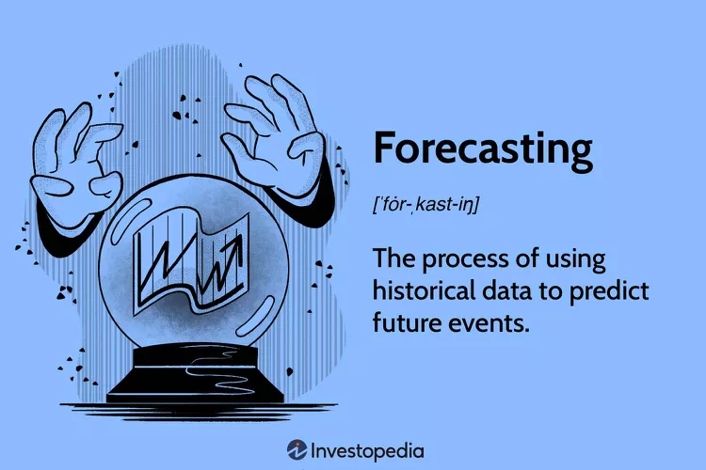
Problem Statement
The main problem our project addresses is inaccurate short-term electricity demand forecasts in utilities, which makes managing energy harder. Traditional methods struggle with complex patterns and sudden demand changes. While ANN and SVM can help, they face issues like high computation needs, sensitivity to poor data, and difficulty predicting unexpected spikes. Our project aims to create a more accurate AI-based model to improve predictions and help utilities manage energy better.
Objectives
To develop an AI-based load forecasting model using ANN and SVM.
To improve the accuracy of short-term electricity demand forecasts.
To compare the performance of ANN and SVM for load forecasting.
To help electric utilities make better decisions with accurate load forecasting.

Slide 7


Data Collection
Data Preprocessing
Splitting the dataset for training and testing
Defining the Model
Train the Model
Evaluating

Slide 8


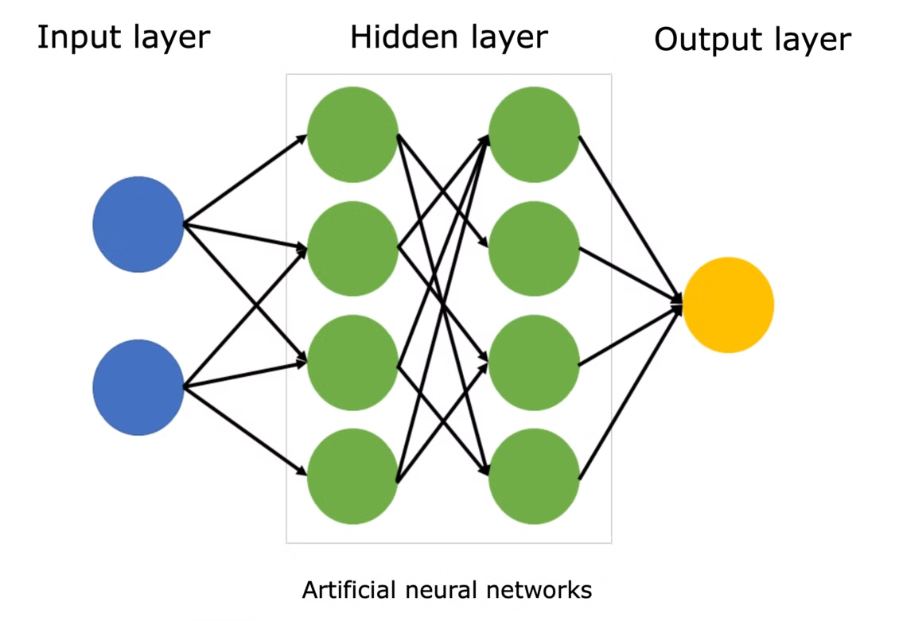


Artificial Neural Networks (ANN) for Load Forecasting
ANN Structure
Feedforward Multilayer Perceptron (MLP-NN) is used for load forecasting.
It consists of three main parts:
Input Layer: Takes in the external data.
Hidden Layers: Processes the data using activation functions to find patterns.
Output Layer: Gives the final prediction result.
Flexible Design: The number of hidden layers and neurons can be adjusted based on the complexity of the problem.
Accurate Predictions
Pattern Recognition
ANNs excel at recognizing complex patterns in historical load data, including weather patterns, economic activity, and seasonal variations.
ANNs can provide accurate load forecasts, even for fluctuating or unpredictable demand patterns.

Slide 9
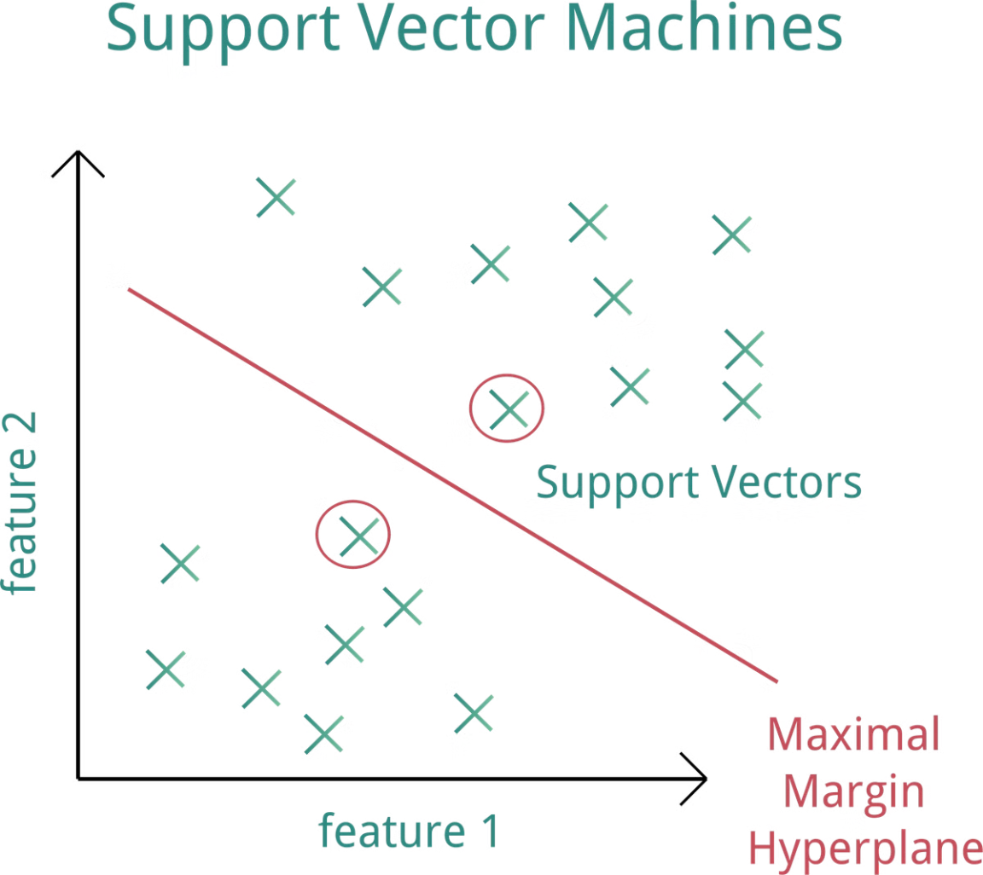
Support Vector Machines (SVM) for Load Forecasting
1
Data Classification
SVMs are powerful machine learning algorithms designed for data classification, effectively separating data points into different categories.
2
High Dimensional Data
SVMs handle high-dimensional data, making them suitable for load forecasting, which involves multiple influencing factors.
3
Non-Linear Relationships
SVMs can capture non-linear relationships between load and influencing variables, leading to more precise forecasts.
4
Hyperplane Formation
A hyperplane separates data points for classification or predicts values for regression, with a wide margin between it and the nearest points. This maximizes accuracy and improves generalization.

Slide 10




Comparative Analysis of ANN and SVM Techniques
⭐Accuracy
1
ANN provides highly accurate predictions, closely matching actual load.
SVM predictions are close but slightly less accurate than ANN.
⭐Generalization
2
ANN may overfit with complex architectures.
SVM generalizes well, especially with smaller datasets and proper kernel selection.
⭐Data Handling
3
ANN performs well with large datasets and complex patterns.
SVM is effective for smaller datasets and handles high-dimensional data efficiently.
⭐Training Efficiency:
4
ANN requires more time for training due to complex network structures.
SVM is faster in training, especially with smaller datasets.

Slide 11

User Interface Design
A simple webpage lets users input data and get predictions instantly.
Why UID?
✅ Makes AI Load Forecasting Accessible.
✅ Allows Real-Time Predictions Without MATLAB Coding.
✅ Works on Web & Mobile (Future Deployment Possibilities).
✅ Easy for Non-Technical Users.
An outline of our page: ai forecasting

Slide 12
Challenges and Limitations of AI-based Load Forecasting
Data Quality
1
AI models need accurate and complete data to make correct forecasts. If the data is poor or missing, it can cause wrong and biased predictions.
Overfitting
2
AI models can become too focused on the training data, making it hard for them to predict accurately when faced with new data.
Interpretability
3
AI models can become too focused on the training data, making it hard for them to predict accurately when faced with new data.

Slide 13

Future Scope
1
2
Integration
Advancements
Future research will focus on integrating AI with other technologies, such as smart grids and demand response, for improved load management.
The development of new and advanced AI techniques, such as deep learning, holds promise for enhancing load forecasting capabilities.
3
Benefits
By leveraging AI, electric utilities can achieve greater operational efficiency, ensure grid reliability, and optimize energy resources, benefitting both the industry and consumers.

Slide 14


Conclusion
Accurate Load Forecasting: Both ANN and SVM predicted short-term electricity load effectively, with ANN being more accurate.
Better Resource Management: AI helps utilities allocate energy efficiently based on seasonal demand.
Promotes Sustainable Energy: Forecasting supports the optimal use of traditional and renewable energy sources and improves energy storage.

Slide 15
REFERANCES:
S. R. Kolla and X. Ni, "Artificial Intelligence Techniques for Load Forecasting in an Electric Utility," Electronics and Computer Engineering Technology, Bowling Green State University, Bowling Green, OH, USA.
Y. Lu, "Short-term load forecasting method based on structural neural network," in Proc. 7th World Congress on Intelligent Control and Automation (WCICA), Shenyang, Liaoning, China, Jun. 25–27, 2008, pp.
OTHER ONLINE RESOURCES

